Slide 1
Dice Rolling Game

Slide 2
Team members
1) OMSHRI PUNDLIK SAWANT
2) SAMARTH DEEPAK KAMTEKAR
3) NAYNA DATTARAM VASHIWALE

Slide 3
Aim and OBjective
Aim
Design a game or gaming platform on Tezos that leverages the benefits of Web3
Objective
Design a game or gaming platform on Tezos that leverages the benefits of Web3 such as open economies, true ownership, and interoperability, to create a new paradigm of gaming experiences for players and developers.

Slide 4
Problem Statement
The challenge is to implement a secure on-chain random number generator, ensuring fair outcomes and preventing any misleading results.
Developers looking to build games on the Tezos blockchain have limited options and resources available which leads us to various difficulties such as follows:-
1. Difficulty designing a game
2. Difficulty building on Tezos
3. Difficulty implementing dice-rolling mechanics

Slide 5
Proposed system
TezRoll is a Tezos-based gaming platform that leverages Web3's open economies, true ownership, and interoperability to create a new paradigm of gaming experiences.
Developers looking to build games on the Tezos blockchain have limited options and resources available but they also have many advantages given below.
Lack of knowledge or experience in game design can make it challenging to create an engaging and enjoyable game.
Learning a new blockchain platform and understanding its development tools can be a steep learning curve for game developers.

Slide 6
Methodology
Build a dice-rolling game. A group of people initially (invite only) will join in, guess a number from the range[1, 6], and then put a bet upon their guess.
The one who guesses the output correctly is treated as the winner(s).
Then the entire pool of bets automatically gets distributed across these winner(s).
The main challenge here is to generate a perfectly random number in the given range (of course on-chain) so as to avoid any misleads.
Once this is achieved, a complete section of games can be further built upon this random module.

Slide 7
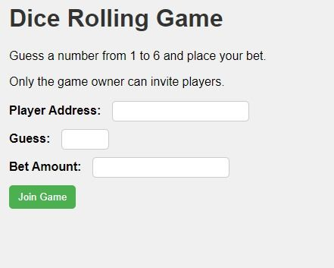
OutPUt

Slide 8
Conclusion
We build a game on the blockchain with the tezos.

Slide 9
Thank you

